Slide 1

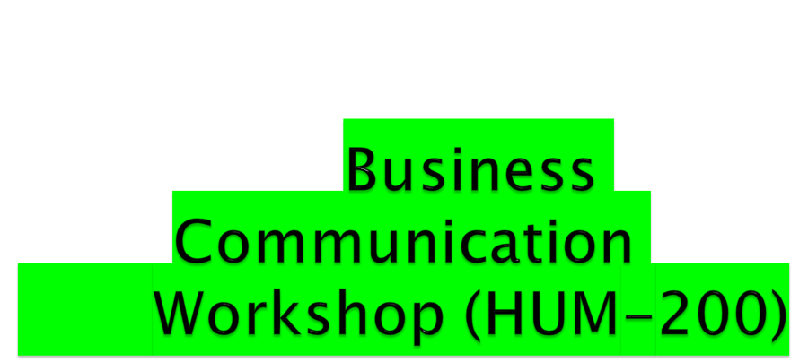
Program: BSEE/BSCE
Instructor: Ms. Saba Akmal

Slide 2

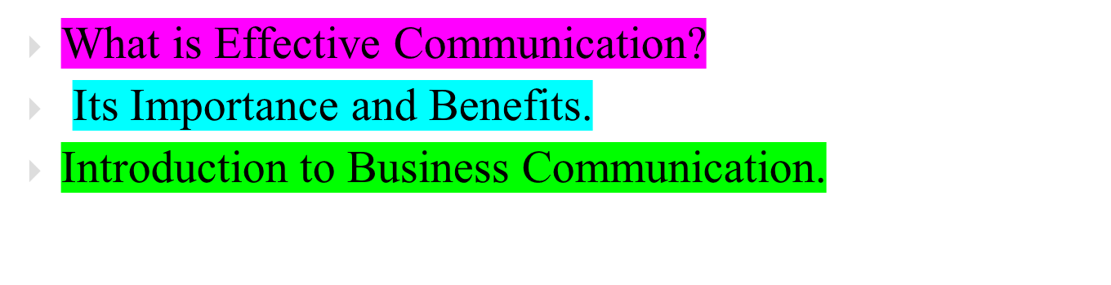

Slide 3
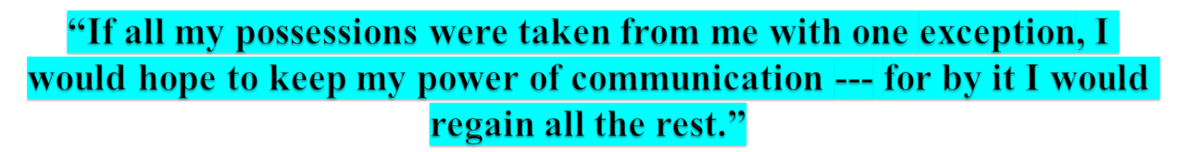
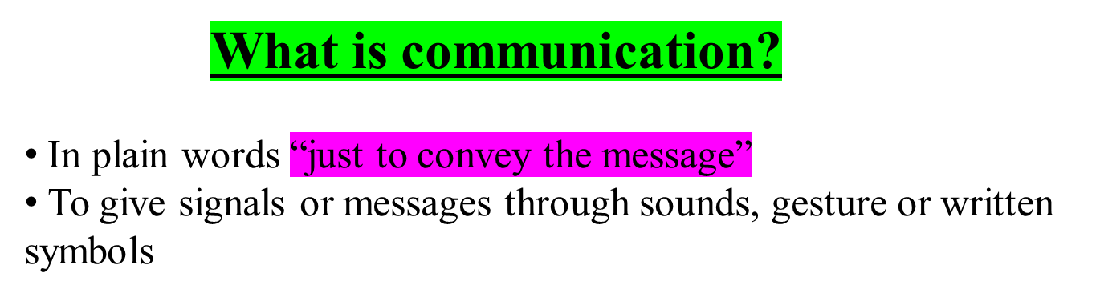
--Daniel Webster, American Journalist

Slide 4

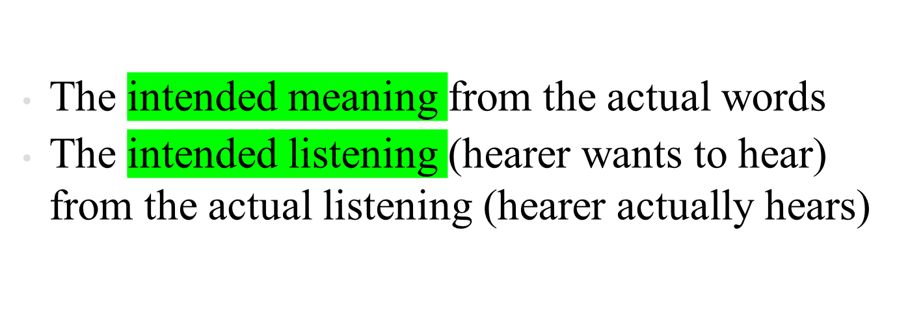

Slide 5

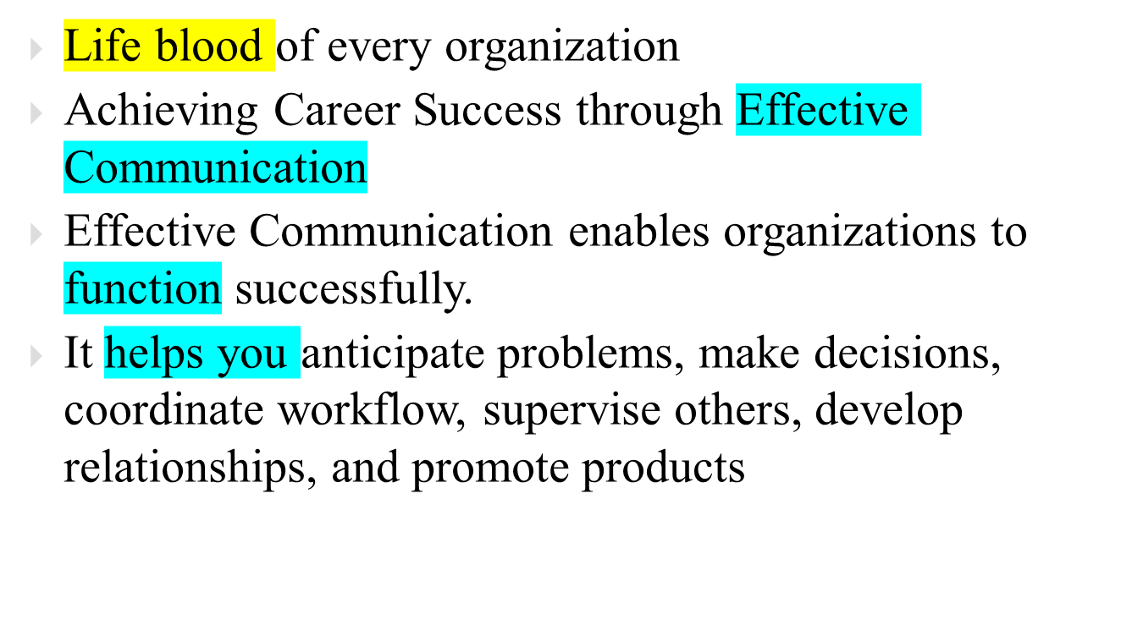

Slide 6
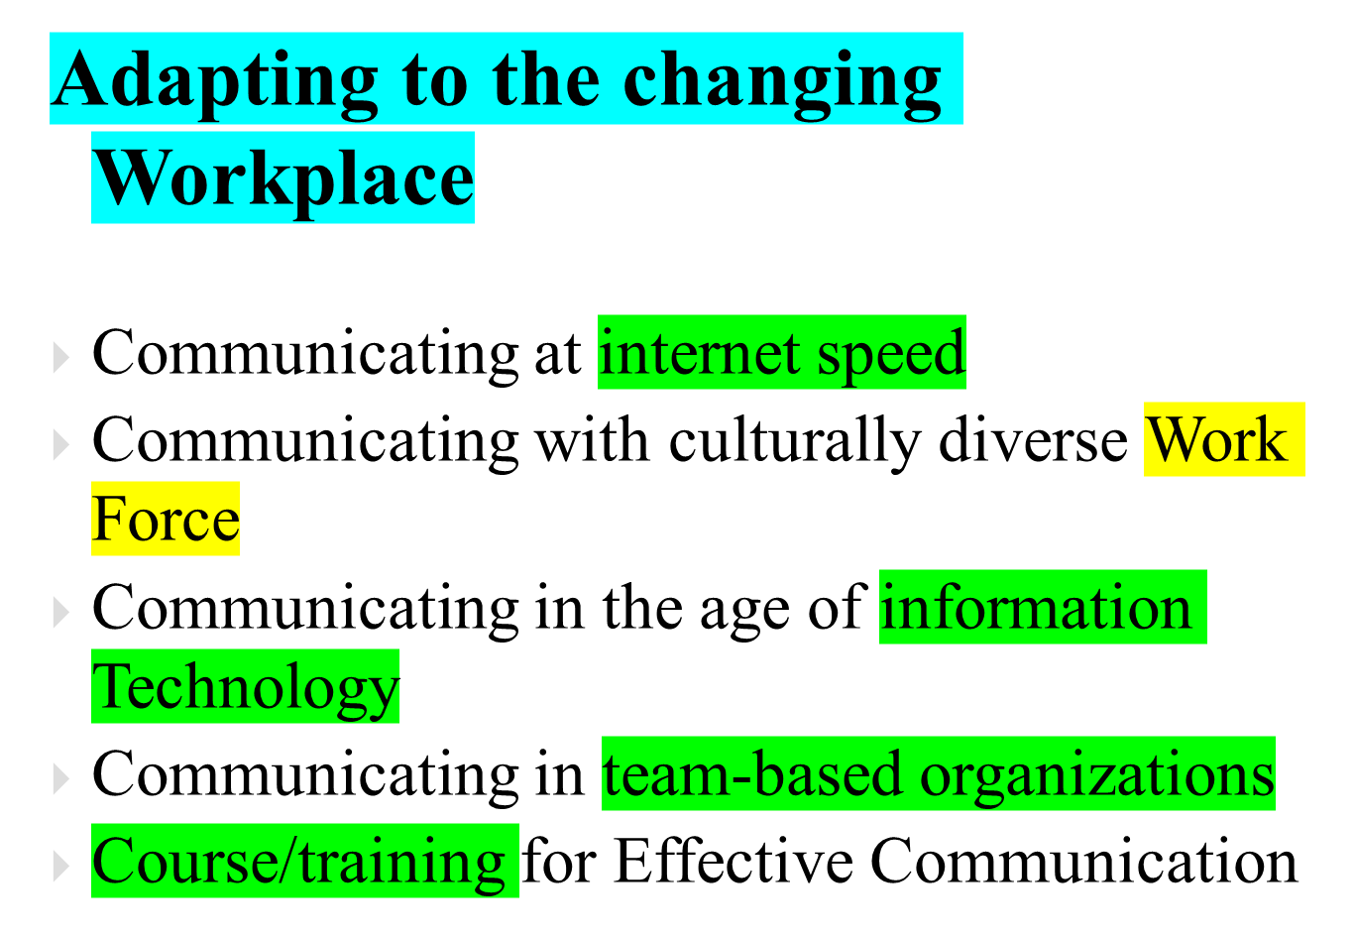

Slide 7
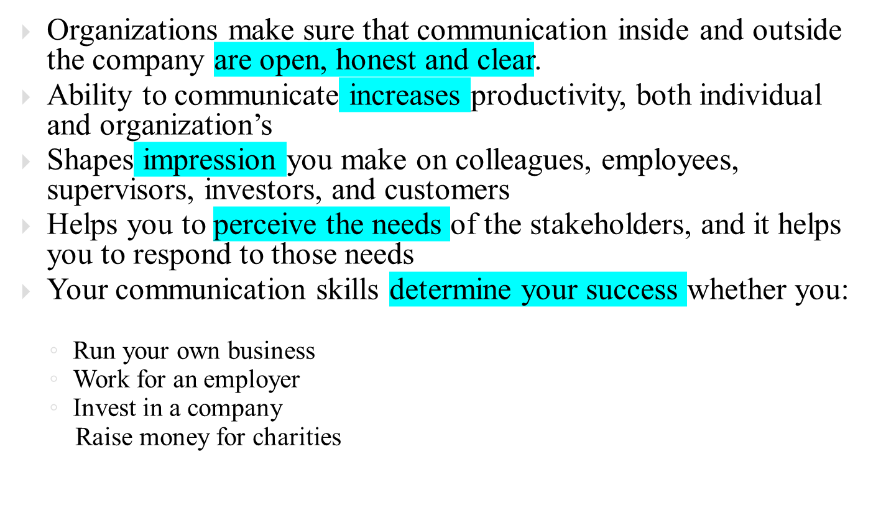

Slide 8
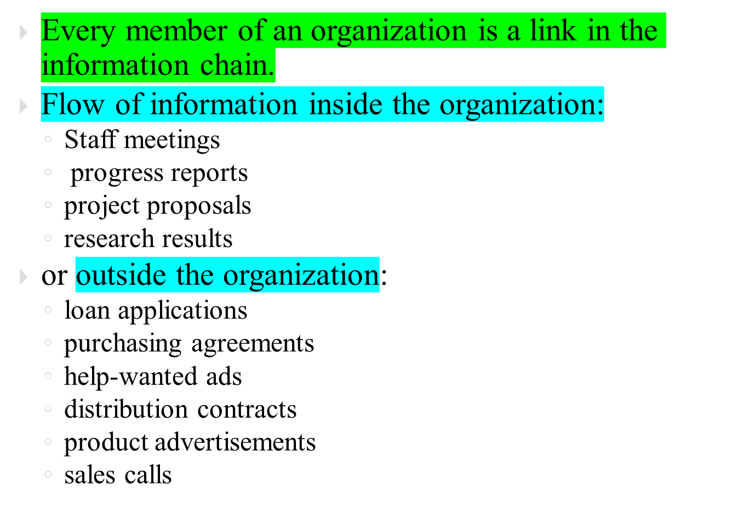

Slide 9
within company you & your coworkers use the information you obtain from one another to guide your activities
a manager coordinates these activities & efforts
constant flow of information up, down & across the organization
As manager, you carry out decision by collecting facts, analyzing them, and transmitting directions to lower-level employees.
Employees serve as the eyes and ears of an organization
You are a contact point in both the external & internal communication networks.

Slide 10

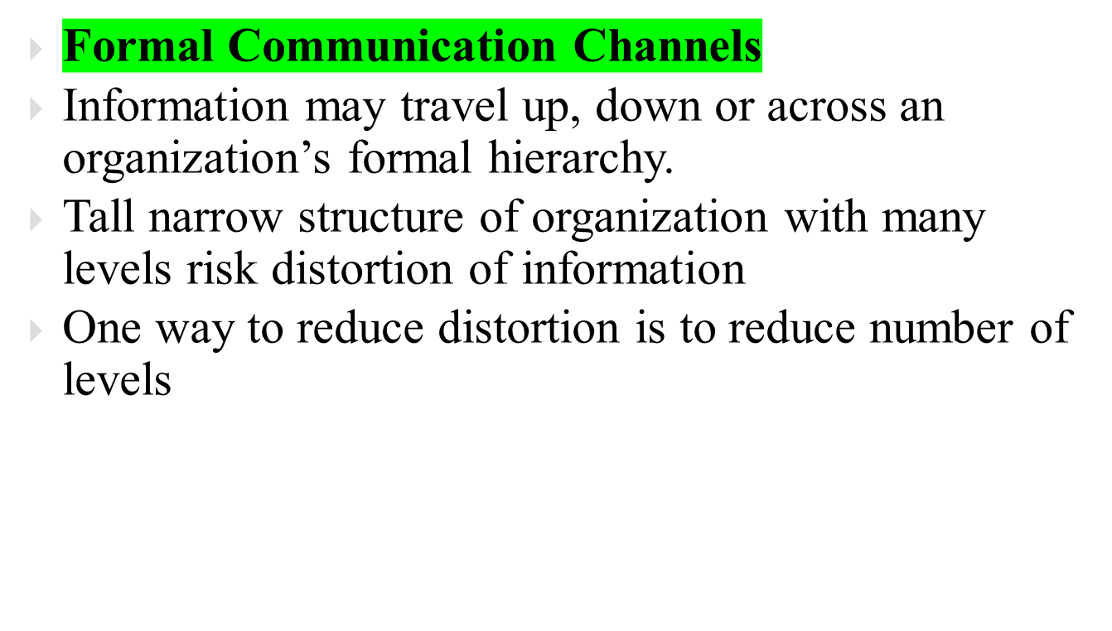

Slide 11

Downward
Upward
Supervisor
Supervisor
Staff
Staff
Horizontal
Department
Department

Slide 12

At most organizations, decisions made at top flow down to people who will carry them out
Downward messages might take the form of a casual conversation, or formal interview between a supervisor and an individual employee, or communicated orally, through workshop or on videotape.
Typical messages include:
  Briefings on the organization’s mission & strategies
  Instructions on how to perform various jobs
  Explanations of policies and procedures
  Feedback on employee performance
  Motivational pep talk

Slide 13
To solve problems and make decisions managers must know what’s going on in the organization
Since they can’t be everywhere at once, executives depend on lower-level employees to furnish them with information like; reports on problems, emerging trends, opportunities for improvement, grievances & performance
The danger is that employees will report only the good news.
Methods for channeling information upwards: group meetings, interviews with employees who are leaving company, employee surveys, etc.
Many companies have set up suggestions systems that encourages employees to submit ideas for improving business

Slide 14

Communication flows from one dept. to another either laterally or diagonally
Bypasses bureaucratic barriers
Efficiency of the company enhances
Horizontal information through Computer networks, and teamwork
Without this co-workers aren’t able to share information, resulting in missed deadlines, duplicated efforts, increased cost, extra time, decreased product quality & deteriorating employee relationship.

Slide 15

Customers
Venders
Investors
Company
Distributors
Journalists
Competitors
Community Representatives

Slide 16

.To inform
.To request
.To persuade
. To motivate
.To build relationships.

Slide 17

Feedback
travels to
sender
NOISE
Sender
has
idea
Sender
encodes
message
Receiver
decodes
message
Receiver
“understands”
message
Channel carries message
Possible additional
feedback to
receiver
NOISE

Slide 18

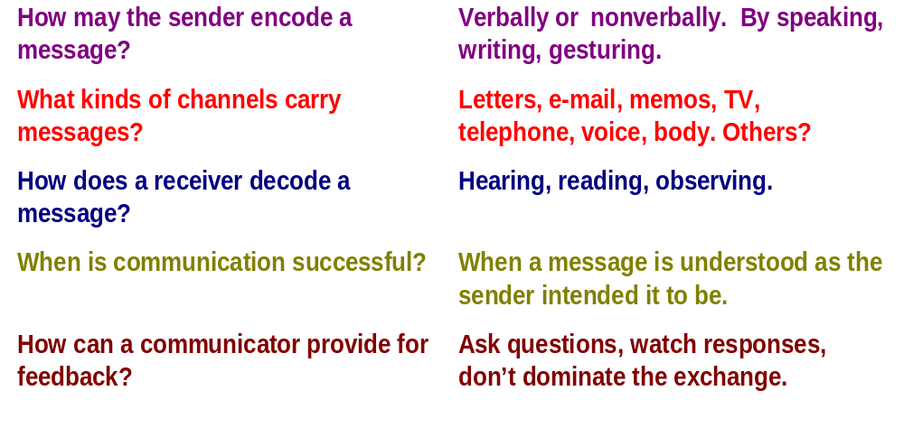
Ch. 1–<number>

Slide 19


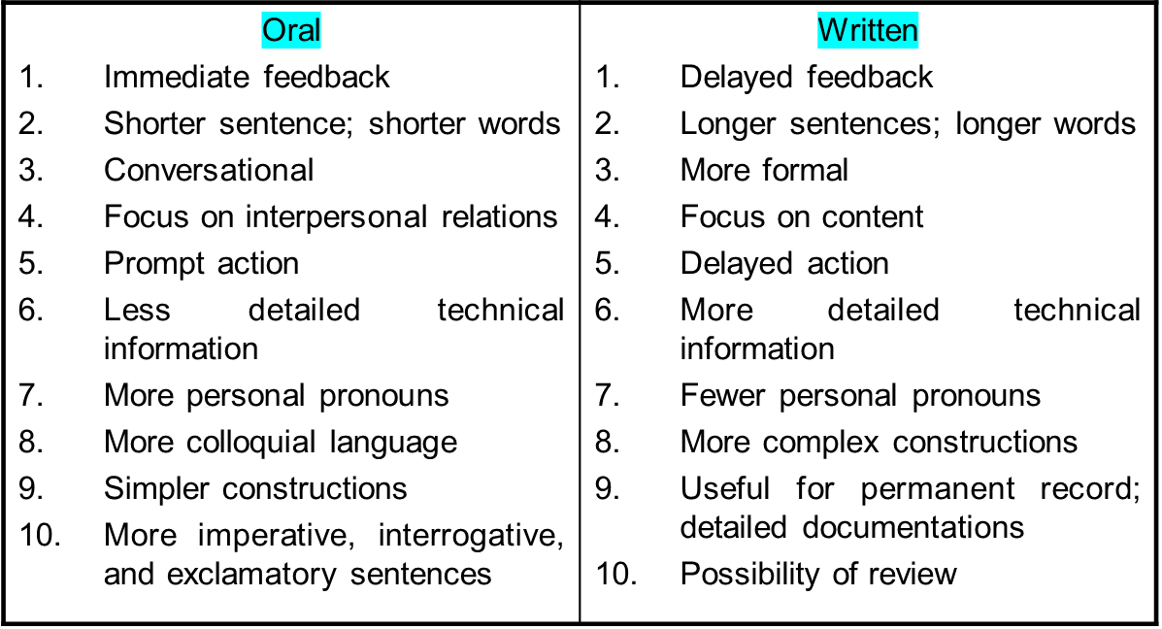

Slide 20

Who Communicator
Whom Receiver
Why Reason
What Contents
Where Place
How Method

Slide 21

Communication is to give signals or messages through sounds, gesture or written symbols
Communication is to Understand intended meaning
Communication is life blood of every organization
It helps you anticipate problems, make decisions, coordinate workflow

Slide 22

Communicating with culturally diverse Work Force
Organizations make sure that communication inside and outside the company are open, honest and clear
Your communication skills determine your success
Internal communication: Information may travel up, down or across an organization’s formal hierarchy: Upward, downward and horizontal communication
External Communication
Goals of communication
The process of communication
Oral and written medium

Slide 23


